Slide 1

HR Analytics using MySQL & Tableau
SRM INSTITUTE OF SCIENCE AND TECHNOLOGY
COLLEGE OF ENGINEERING AND TECHNOLOGY
DEPARTMENT OF ELECTRONICS AND COMMUNICATION
18CSE415J – FOUNDATION OF ANALYTICS
Mini-Project Presentation
DEVANANDA REDDY : RA2211004010086
MASKU RAHUL : RA2211004010087
Guide name and Designation : Dr. SUBHA T, Assistant Professor

Slide 2
OBJECTIVE
The project integrates MySQL for robust data management and Tableau for dynamic visualizations, aiming to revolutionize HR practices with data-driven insights and informed decision-making. This comprehensive approach empowers HR professionals to optimize workforce management and align strategies with the evolving demands of the modern business landscape.

Slide 3
PROBLEM STATEMENT
The current challenge in human resource management lies in the lack of a comprehensive and scalable solution for analytics. This project addresses this gap by integrating MySQL for efficient data management and Tableau for advanced visualizations, aiming to empower HR professionals with data-driven insights, informed decision-making, and the optimization of HR practices within organizations.

Slide 4
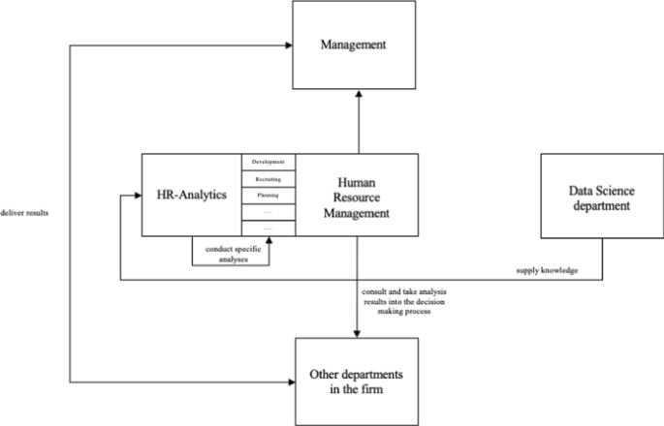
FLOW CHART

Slide 5
SOFTWARE REQUIREMENTS
The "HR Analytics using MySQL & Tableau Software" project involves the utilization of the following software:
1. MySQL:
- Purpose: MySQL is employed as the relational database management system (RDBMS) for efficient storage, management, and retrieval of diverse HR datasets.
2. Tableau:
- Purpose: Tableau is used for data visualization, creating interactive dashboards to represent HR data insights visually..
3. Excel (Optional):
- Purpose: Excel may be used for data preprocessing and analysis before integration into MySQL.
4. Python (Optional):
- Purpose: Python may be used for advanced data preprocessing or statistical analysis tasks.
These software tools collectively form an integrated environment for efficient data storage, analysis, and visualization, facilitating a comprehensive approach to HR analytics within the project. The combination of MySQL and Tableau serves as the backbone for transforming raw HR data into meaningful insights for informed decision-making and strategic planning.

Slide 6
IMPLEMENTATION-CODE SNIPPET AND RESULT
COUNTS OF EMPLOYEE, ATTRITION, ATTRITION RATE, ACTIVE EMPLOYEES, AVG.AGE:-
EDA CODE:-
# Assuming 'Employee Count' is a column in your DataFrame
# Check if 'Employee Count' column is present in the DataFrame
if 'Employee Count' in df.columns:
# Calculate the sum of 'Employee Count'
total_employee_sum = df['Employee Count'].sum()
# Display the sum of 'Employee Count'
print(f'Sum of Employee Count: {total_employee_sum}')
else:
print("Error: 'Employee Count' column not found in the DataFrame.")

Slide 7
#--------------------------------------------------------------------------------------------Sum of Employee Count
# Assuming 'Attrition' is a column in your DataFrame
# Check if 'Attrition' column is present in the DataFrame
if 'Attrition' in df.columns:
# Calculate the attrition rate
attrition_count = df['Attrition'].value_counts().get('Yes', 0)
total_employees = len(df)
attrition_rate = (attrition_count / total_employees) * 100 if total_employees > 0 else 0
# Display the attrition rate
print(f'Attrition Rate: {attrition_rate:.2f}%')
else:
print("Error: 'Attrition' column not found in the DataFrame.")
# Assuming 'Attrition' is a column in your DataFrame
#--------------------------------------------------------------------------------------------Attrition Rate
# Check if 'Attrition' column is present in the DataFrame
if 'Attrition' in df.columns:
# Calculate the count of active employees
attrition_count = df['Attrition'].value_counts().get('Yes', 0)
total_employees = len(df)
active_employees = total_employees - attrition_count
# Display the count of active employees
print(f'Active Employees: {active_employees}')
else:
print("Error: 'Attrition' column not found in the DataFrame.")

Slide 8
#--------------------------------------------------------------------------------------------Active Employees
# Assuming 'Age' is a column in your DataFrame
# Check if 'Age' column is present in the DataFrame
if 'Age' in df.columns:
# Calculate the average age
average_age = df['Age'].mean()
# Display the average age
print(f'Average Age: {average_age:.2f}')
else:
print("Error: 'Age' column not found in the DataFrame.")
#--------------------------------------------------------------------------------------------Average Age
# Assuming 'Attrition' is a column in your DataFrame
# Check if 'Attrition' column is present in the DataFrame
if 'Attrition' in df.columns:
# Calculate the count of employees with attrition
attrition_count = df['Attrition'].value_counts().get('Yes', 0)
# Display the count of attrition
print(f'Attrition Count: {attrition_count}')
else:
print("Error: 'Attrition' column not found in the DataFrame.")
#------------------------------------------------------------------------------------------ Attrition Count

Slide 9
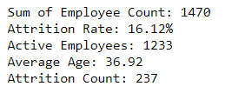
OUTPUT OBTAINED:-

Slide 10
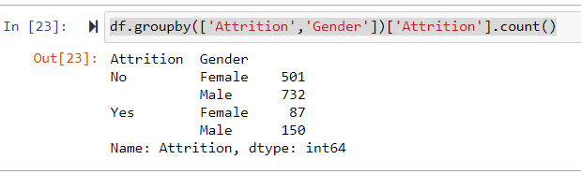
2. ATTRITION BY GENDER:-
CODE AND COUNT OUTPUT:-

Slide 11
CODE FOR GRAPH:-
df.groupby(['Attrition','Gender'])['Attrition'].count()
import seaborn as sns
import matplotlib.pyplot as plt
import pandas as pd
# Assuming df is your DataFrame
# Group by 'Attrition' and 'Gender' and count occurrences
count_series = df.groupby(['Attrition', 'Gender'])['Attrition'].count()
# Convert the MultiIndex Series to DataFrame for easy plotting
count_df = count_series.reset_index(name='Count')
# Create a countplot
plt.figure(figsize=(8, 6))
sns.set(style="whitegrid")
sns.barplot(x='Attrition', y='Count', hue='Gender', data=count_df, palette='viridis')
# Add labels and a title
plt.xlabel('Attrition')
plt.ylabel('Count')
plt.title('Countplot of Attrition by Gender')
# Show the plot
plt.show()

Slide 12
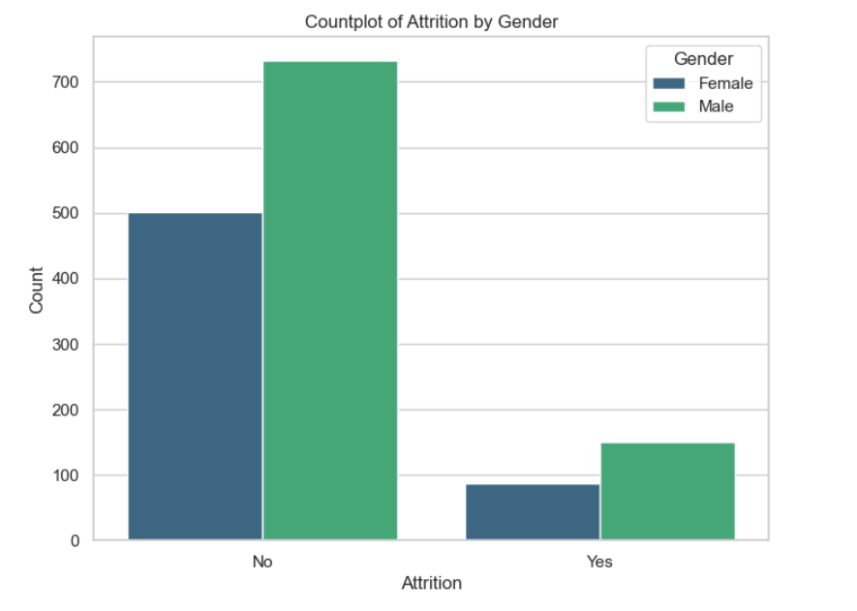

Slide 13
3. DEPARTMENT WISE ATTRTIION:-
CODE:-
import seaborn as sns
import matplotlib.pyplot as plt
# Assuming 'Department' and 'Attrition' are columns in your DataFrame
# Assuming 'Attrition' column has values like 'Yes' or 'No'
# Create a DataFrame with department-wise attrition counts
attrition_by_department = df.groupby(['Department', 'Attrition']).size().reset_index(name='Count')
# Filter for only the 'Yes' (attrition) values
attrition_yes = attrition_by_department[attrition_by_department['Attrition'] == 'Yes']
# Plotting a pie chart
plt.figure(figsize=(8, 8))
plt.pie(attrition_yes['Count'], labels=attrition_yes['Department'], autopct='%1.1f%%', startangle=140, colors=sns.color_palette('pastel'))
# Add a title
plt.title('Department-wise Attrition')
# Show the plot
plt.show()

Slide 14
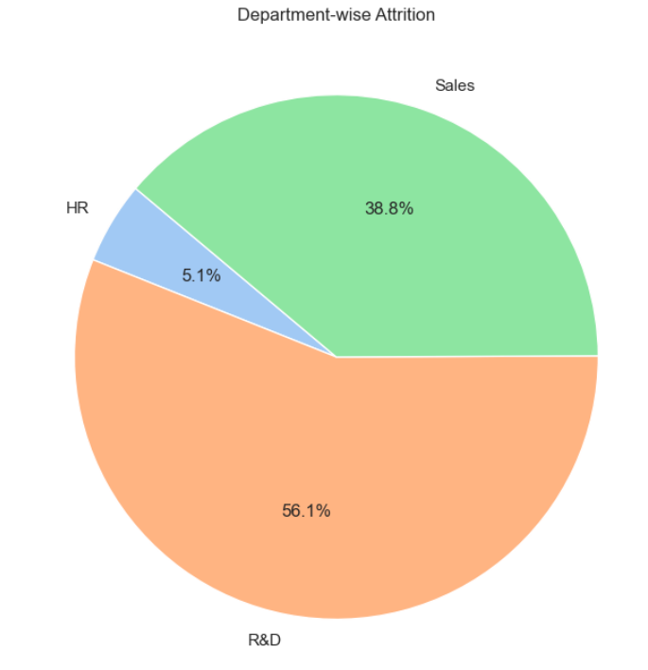

Slide 15
4. NO OF EMPLOYEE BY AGE GROUP:-
CODE:-
import matplotlib.pyplot as plt
# Assuming 'Age' is a column in your DataFrame
# Assuming 'Age' is a numeric column
# Define the age bins and labels
age_bins = [18, 25, 35, 45, 55, 65, 100] # You can adjust these bins as needed
age_labels = ['18-25', '26-35', '36-45', '46-55', '56-65', '66+']
# Create a new column with age groups
df['AgeGroup'] = pd.cut(df['Age'], bins=age_bins, labels=age_labels, right=False)
# Plotting a bar chart
plt.figure(figsize=(10, 6))
df['AgeGroup'].value_counts().sort_index().plot(kind='bar', color='skyblue')
# Add labels and a title
plt.xlabel('Age Group')
plt.ylabel('Number of Employees')
plt.title('Number of Employees by Age Group')
# Show the plot
plt.show()

Slide 16
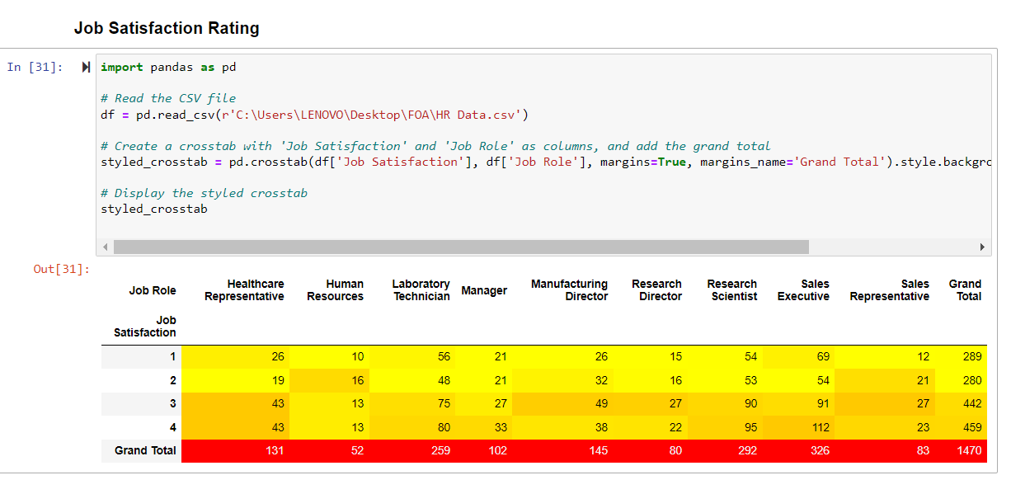

Slide 17
6. EDUCATION FIELD WISE ATTRITION:-
CODE:-
import pandas as pd
import matplotlib.pyplot as plt
import seaborn as sns
# Read the CSV file
df = pd.read_csv(r'C:\Users\LENOVO\Desktop\FOA\HR Data.csv')
# Create a crosstab to calculate the sum of attrition counts by education field
education_field_attrition_sum = df.groupby('Education Field')['Attrition'].apply(lambda x: (x == 'Yes').sum()).reset_index(name='AttritionSum')
# Sort by attrition count in descending order
education_field_attrition_sum = education_field_attrition_sum.sort_values(by='AttritionSum', ascending=False)
# Plot the bar chart
plt.figure(figsize=(12, 8))
sns.set(style="whitegrid")
# Create a bar chart for education field-wise sum of attrition counts
sns.barplot(x='AttritionSum', y='Education Field', data=education_field_attrition_sum, palette='viridis')
# Add labels and a title
plt.xlabel('Sum of Attrition Count')
plt.ylabel('Education Field')
plt.title('Education Field Wise Sum of Attrition Counts (Descending Order)')
# Show the plot
plt.show()

Slide 18
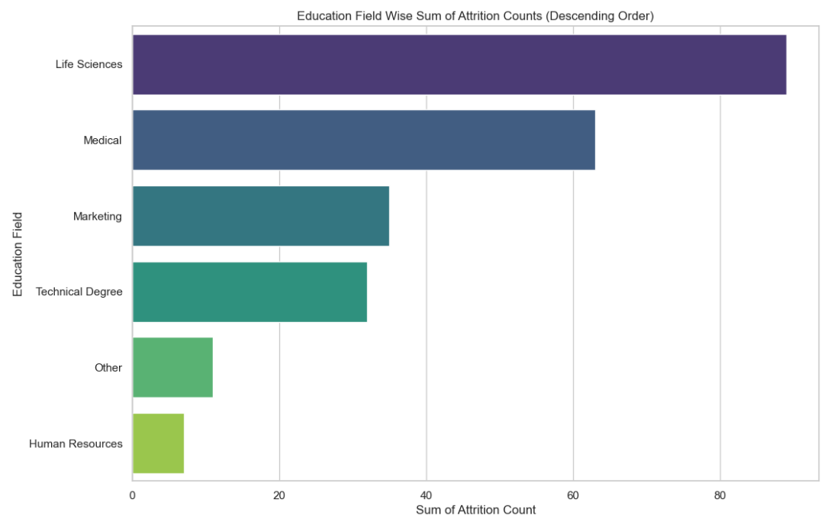

Slide 19
7. TTRITION RATE BY GENDER FOR DIFFERENT AGE GROUP:-
CODE:-
import seaborn as sns
import matplotlib.pyplot as plt
import pandas as pd
# Assuming 'Age', 'Gender', and 'Attrition' are columns in your DataFrame
# Check if all columns are present in the DataFrame
if all(col in df.columns for col in ['Age', 'Gender', 'Attrition']):
# Create a new column with age groups
age_bins = [18, 25, 35, 45, 55, 65, 100]
age_labels = ['18-25', '26-35', '36-45', '46-55', '56-65', '66+']
df['AgeGroup'] = pd.cut(df['Age'], bins=age_bins, labels=age_labels, right=False)
# Create a DataFrame with attrition counts by age group and gender
attrition_by_age_gender = df.groupby(['AgeGroup', 'Gender', 'Attrition']).size().reset_index(name='Count')
# Calculate attrition rates
attrition_by_age_gender['AttritionRate'] = attrition_by_age_gender.groupby(['AgeGroup', 'Gender'])['Count'].transform(lambda x: (x / x.sum()) * 100)
# Create a lollipop chart
plt.figure(figsize=(12, 8))
sns.set(style="whitegrid")
# Lollipop chart for attrition rates by gender
sns.lineplot(x='AgeGroup', y='AttritionRate', hue='Gender', marker='o', data=attrition_by_age_gender)
# Scatter plot to show individual data points
sns.scatterplot(x='AgeGroup', y='AttritionRate', hue='Gender', marker='o', data=attrition_by_age_gender, legend=False)
# Add labels and a title
plt.xlabel('Age Group')
plt.ylabel('Attrition Rate (%)')
plt.title('Attrition Rate by Gender for Different Age Groups')
# Show the plot
plt.show()

Slide 20
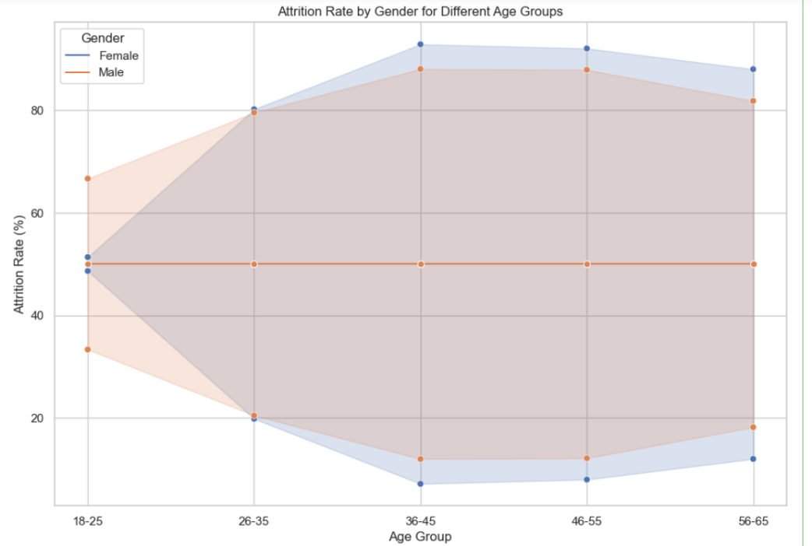

Slide 21
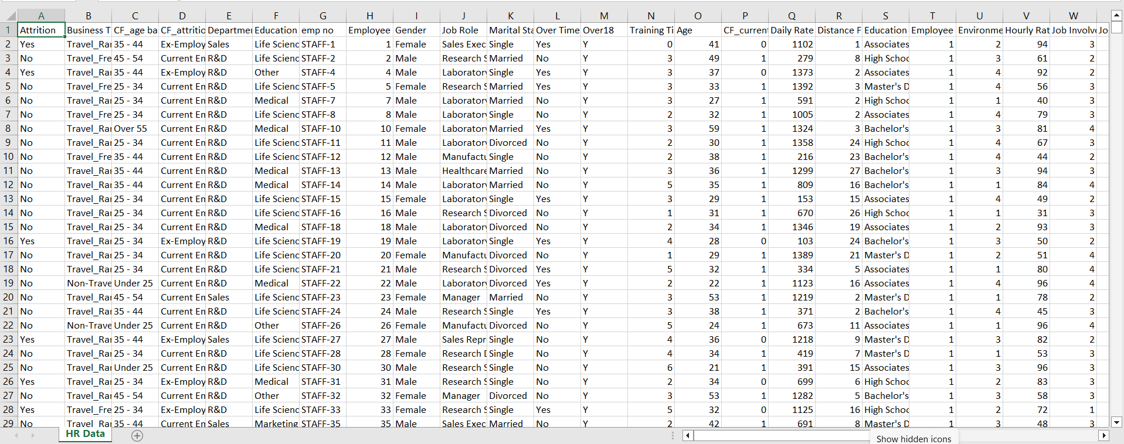
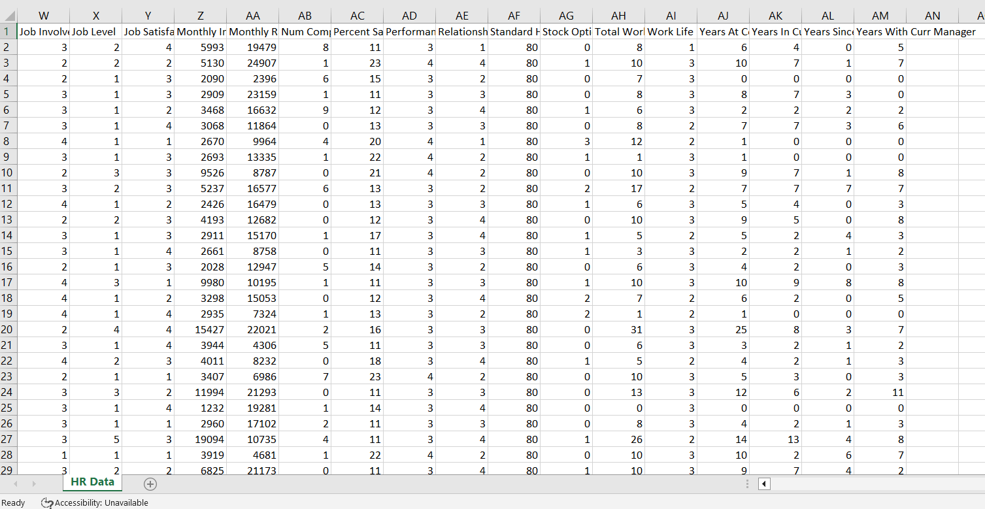
DATASET SNIPPETS

Slide 22
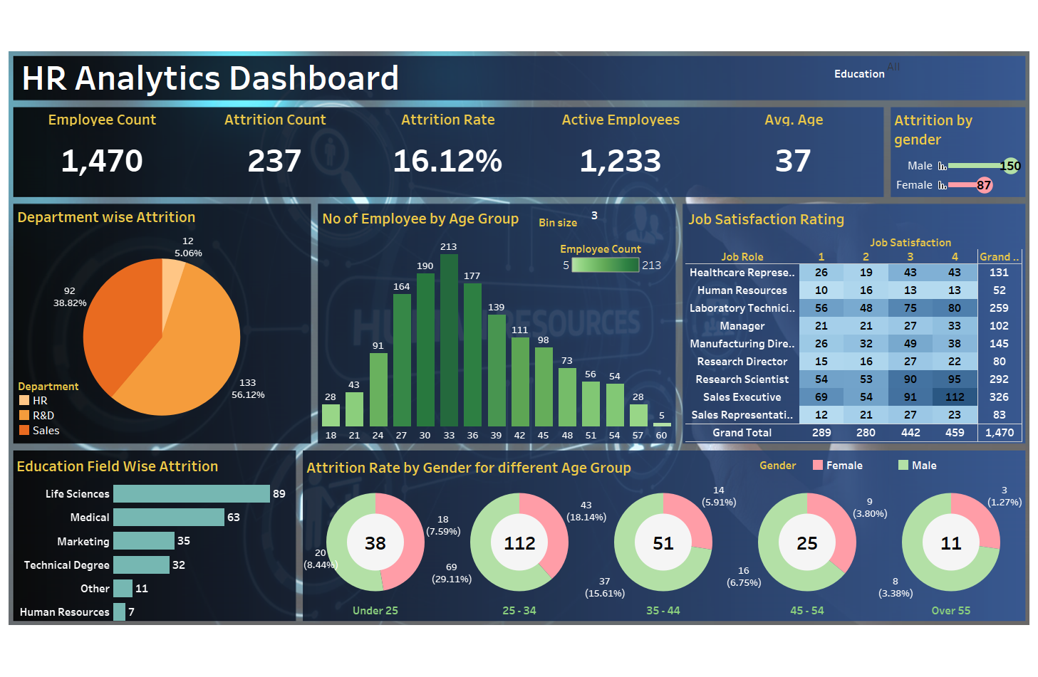
FINNAL TABLEAU RESULT

Slide 23
CONCLUSION
In conclusion, the integration of HR Analytics using MySQL and Tableau Software marks a pivotal advancement in human resource management. The project highlights the transformative impact of adopting a data-driven approach, providing comprehensive insights into workforce dynamics. MySQL's robust data infrastructure, coupled with Tableau's visualization capabilities, empowers HR professionals to make informed decisions based on a holistic understanding of employee demographics, performance metrics, and key HR indicators. The interactive dashboards created foster a collaborative and data-centric culture, enhancing accessibility and engagement. This strategic alignment contributes to efficient HR planning, optimization, and the establishment of a scalable data management system. In essence, the project sets the stage for a new era in HR Analytics, where the synergy of MySQL and Tableau propels organizations toward excellence in workforce management through precision and insight.

Slide 24
Thanks

